Slide 1
To Set
Goals
lausd.org/human-relations

Slide 2
Would You Rather
Meet a superhero
Meet a historical figure
lausd.org/human-relations

Slide 3
Goal Setting
lausd.org/human-relations
Notes:
https://www.youtube.com/watch?v=XGd0gq5Fgjc&feature=youtu.be

Slide 4
Pair Share
We just heard about a bunch of goals other kids have.
Share with your partner a goal you have.
lausd.org/human-relations

Slide 5
Why Set Goals?
Goal setting is not easy! It is a skill that must be practiced.
Goal setting actually helps us in other ways:
Teaches us to take responsibility for our actions
Promotes a can-do attitude
Ensures a lifelong habit
lausd.org/human-relations

Slide 6
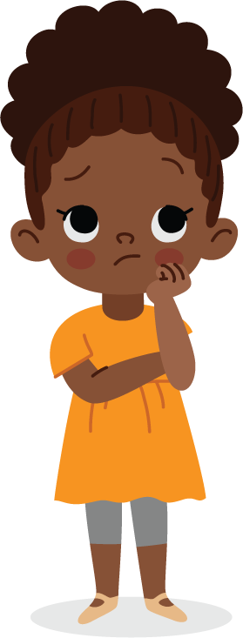
Choose A Big Goal
Pick one thing that you really want to do.
Imagine a world where anything is possible, would you want to do?
Have the courage to be brave and think big!
lausd.org/human-relations

Slide 7
Pair Share
Based on what we just talked about, what is one BIG goal you can think of right now?
lausd.org/human-relations
lausd.org/human-relations

Slide 8
Goal Setting
lausd.org/human-relations
Notes:
https://www.youtube.com/watch?v=XrsERz952qM

Slide 9
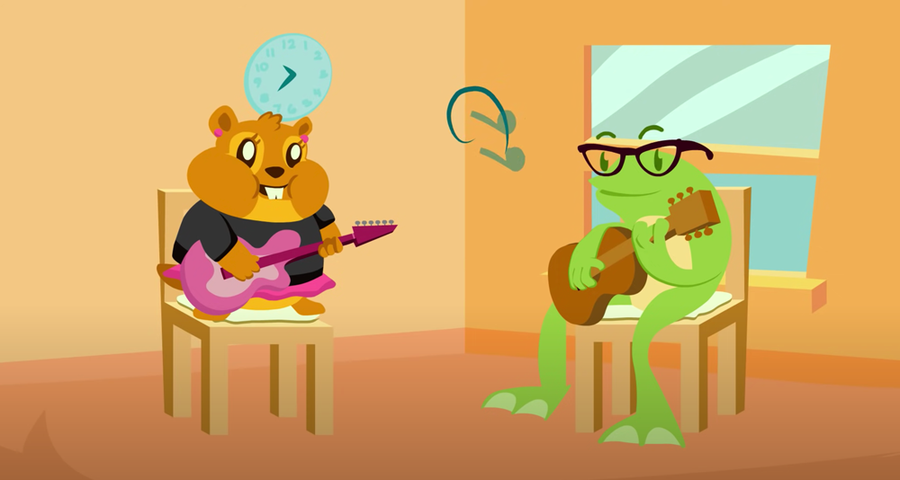
Starting Small
In the video we learned that setting smaller goals can help make it easier to reach our goal.
The goal of the character in the video: Become a Rockstar
Who remembers what their smaller goals were?
lausd.org/human-relations

Slide 10
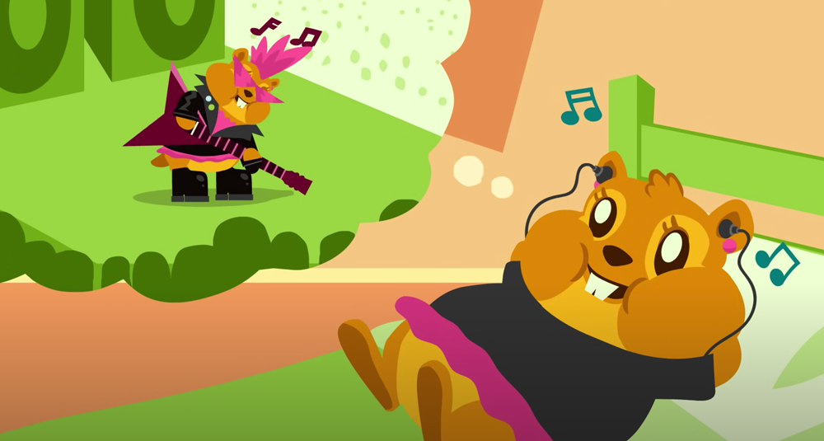
Starting Small
The character in the video set smaller goals to buy a guitar and learn to jam!
How did they reach those goals?
lausd.org/human-relations

Slide 11
Starting Small
Remember: each smaller goal is going to take work and dedication. BUT, when we are successful at the smaller goals, we feel excited to keep working towards our BIG goal!
lausd.org/human-relations

Slide 12
Pair Share
If we try to reach our goal alone it's easy to give up. The character in the video got a guitar teacher to help them reach their goal.
Share with your partner a grown up who has helped you reach your goals!
lausd.org/human-relations

Slide 13
Make A Choice!
BONUS: Write down!
By writing it down your goal, you are 42% more likely to achieve it.
Reaching goals is not easy - it takes hard work!
But it's harder time to achieve the goals that you don't make a choice to set!
lausd.org/human-relations

Slide 14
Discussion
What is a goal you can choose today?
lausd.org/human-relations

Slide 15
Check Out
What will you do for yourself today?
Move your body
Draw
Sing
Drink water
Meet friends
Gratitude journal
Meditate
Take breaks
lausd.org/human-relations

Slide 16
Committed to fostering a safe and respectful District, school and community culture where the seeds of peace and justice are down so that all students and staff can lead safe, purposeful and academically fruitful lives.
Connect with us at bit.ly/LAUSD-HRDE
lausd.org/human-relations

